Slide 1
2014 Tax-Exempt Organization’s Financial Data

Slide 2
What’s the dataset?
Exempt Organizations’ 990 Tax Returns Filed in Calendar Year 2014.
Downloadable as a .dat file
245 fields! 299,405 Records!
Financial data, which is typically scrutinized more than non-financial data.
“Wow! This must be juicey data!” ...or so I thought

Slide 3
Hypothesis
Hypothesis: Nonprofits’ efficacy can be predicted by some elements of its financial information.
Alternative Hypothesis: Nonprofits’ efficacy can not be predicted by some elements of its financial information.

Slide 4
Problems with Hypothesis
Hypothesis:
“Nonprofits’ efficacy can be predicted by some elements of its financial information.”
I did not not define efficacy in any way!
I did not define what my output would be.
I did not define my threshold for what would be considered ‘effective’.
So, it was a bad hypothesis! What should I do about that?!

Slide 5
Perils of a Bad Hypothesis
“Nonprofits’ efficacy can be predicted by some elements of its financial information.”
How should I define efficacy, anyway?!
What is the organization trying to do?
Answer: It depends on the type of organization!
Follow-up: What types of organizations are there?

Slide 6
Perils of Recovering from a Bad Hypothesis
I decided to explore my data in order to inform an improved hypothesis….
Oh No’s! That’s not the right way to go about things!
Once you’ve begun exploring your data it’s very difficult to analyze it objectively!
I intended to predict, but found it very difficult to not interpret!

Slide 7
Subsection = Type of Nonprofit
There are 28 different subsections under which nonprofits can file. These subsections represent the type of nonprofit that the organization will file as.
Corporations organized under acts of Congress, which includes federal credit unions, and serve as instrumentalities of the United States
Corporations created to hold titles for property owned by another nonprofit.
3 (More on this in a moment)
Social welfare organizations
Labor and agriculture organizations
Business leagues
Social and recreation clubs
Fraternal beneficiary societies
Voluntary employees’ beneficiary associations
Domestic fraternal beneficiary societies
Teachers' retirement fund associations
Benevolent life insurance associations
Cemetery companies
State-chartered credit unions
Mutual insurance companies
Corporations organized to finance crop operations
Supplemental unemployment compensation trusts
Employee-funded pension trusts
Veterans’ organizations
Group legal services plans
Black lung benefit trusts
Withdrawal liability payment funds
Associations of past and present members of the armed services
Trusts (described in section 4049 of ERIS74)
Holding companies for pensions and other entities
State-sponsored high-risk health insurance plans
State-sponsored workers' compensation reinsurance plans
Section 4947(a)(1) Nonexempt Charitable Trust (Treated as Private Foundation)

Slide 8
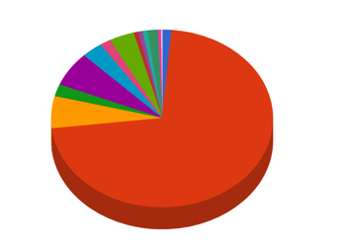
Subsection 3
Of the 28 subsections 72% of all Nonprofits filing 2014 federal tax form 990 filed as type 3. They are:
“Organizations for any of the following purposes: religious, educational, charitable, scientific, literary, testing for public safety, fostering national or international amateur sports competition (as long as it doesn’t provide athletic facilities or equipment), or the prevention of cruelty to children or animals”
They are tax exempt and donations to them are federally tax exempt! !

Slide 9
Honorable Mention:
7 other subsections represented nearly all of the remaining agencies
After section 3, the next highest rate of subsection registrants were 6% of all agencies.
6%
Business leagues
6%
Social welfare organizations
4%
Voluntary employees’ beneficiary associations
3%
Social and recreation clubs
2%
Labor and agriculture organizations
2%
Fraternal beneficiary societies
2%
Veterans’ organizations

Slide 10
Continued Trials of a Bad Hypothesis
Hypothesis: “Nonprofits’ efficacy can be predicted by some elements of its financial information.”
So, how should I define efficacy?!
What is the organization trying to do?
It depends on the type of organization, but the information available to us on type of organization is vague.
Not all agencies provide ‘services’ and no organization reports services provided or expenses spent on services provided!
Where is their budget going?

Slide 11
Follow the money!
56% of all organizations have reported having both employees and compensation for employees. Of those agencies:
The average compensation per employee per tax year is $36,193
36% of all organizations’ total expenses go to employee compensation.
However, on average only 9% percent of each agency's’ total expenses goes to employee compensation.
How is this possible? Both the total expenses and the expenses spent on employee compensation have giant standard deviations!

Slide 12
How to follow the money?
What determines the ratio of agencies’ expenses on employee compensation to their total expenses?
First, we identify that ratio with what must surely be reasonable data!
‘emplyee_comp_to_totalexpenses_ratio’ = total_employee_comp / total_expenses
Sweet! Now I have a new and interesting field!

Slide 13
How to follow the money? (Cont)
Some agencies pay their employees more than others. Is that predicable?
Let’s look at the ratio of expenses on employee compensation to the number of employees, per agency!
‘employee_comp_ratio’ = total_employee_comp / count_employees
Glee! Another interesting field!

Slide 14
But there were a few tiny problems….
My fields are string formatted and don’t work well as-is for models!
My new fields also didn’t work because they were String formatted.
Finally, “Follow the money” is still not a hypothesis!

Slide 15

Make all of the fields useful!
.

Slide 16
Cleaning Existing Fields:
Importing the .dat file made all fields string formatted, regardless of content!
So I formatted all fields that needed to be read as numbers as integers.
Expenses were sometimes entered as negative numbers
So I set numeric fields to their absolute values.
Boolean fields with Y/N values are difficult to use in many models.
So I created 1/0 equivalent fields

Slide 17
Deriving New Fields:
I want to see anything interesting about how the agencies were expending their budgets. So I made the following fields:
A field representing all expenses on grants (‘total_grants’)
A field representing all expenses minus all expenses on grants (‘’expns_minus_grants).
A field representing all expenses spent on employee compensation (‘total_emply_comp’).
A field representing the ratio of employee compensation to workers ('emplyee_comp_ratio'). Now, as an integer!
A field representing the ratio of employee compensation to total expenses (‘emplyee_comp_to_totalexpenses_ratio’) Now, as an integer!

Slide 18
Unexpected Issues with New Fields
Both of the newly derived 'emplyee_comp_ratio' and ‘emplyee_comp_to_totalexpenses_ratio’ got some NAN and inf (infinity) values because sometimes one or more of the fields used to derived them = 0!
I decided not to drop these records because they weren’t NULL values; they represented real situations.
So I decided to create classifying fields defined by quartile of each ratio as well as if any the fields used to derive each ratio were equal to 0.

Slide 19
Making Classifying Buckets:
For 'emplyee_comp_ratio':
I made a new dataframe where neither of the fields compensation or employees (used to derive 'emplyee_comp_ratio') are = 0.
For the records in the new dataframe I create a mask for each quartile.
Q1_emplyee_comp_ratio is True if 'emplyee_comp_ratio' is within its first quartile
Q2_emplyee_comp_ratio is True if 'emplyee_comp_ratio' is within its second quartile
Q3_emplyee_comp_ratio is True if 'emplyee_comp_ratio' is within its third quartile
Q4_emplyee_comp_ratio is True if 'emplyee_comp_ratio' is within its fourth quartile
I also make a mask for if only the employee compensation is 0, a mask for if the number of employees is 0, and a mask for if both are 0.
I then map these 7 masks to one field ‘int_compensation_classifier’, which is a numeric classifier with one number representing each bucket. .

Slide 20
Making Classifying Buckets (Continued):
For ‘emplyee_comp_to_totalexpenses_ratio’:
I made a new dataframe where neither of the fields compensation or employees (used to derive 'emplyee_comp_ratio') are = 0.
For the records in the new dataframe I create a mask for each quartile.
Q1_emplyee_comp_ratio is True if emplyee_comp_to_totalexpenses_ratio is within its first quartile
Q2_emplyee_comp_ratio is True if emplyee_comp_to_totalexpenses_ratio is within its second quartile
Q3_emplyee_comp_ratio is True if emplyee_comp_to_totalexpenses_ratio is within its third quartile
Q4_emplyee_comp_ratio is True if emplyee_comp_to_totalexpenses_ratio is within its fourth quartile
I also make a mask for if only the employee compensation is 0, a mask for if the number of employees is 0, and a mask for if both are 0.
I then map these 7 masks to one field ‘int_emplyee_comp_to_totalexpenses_classifier’, which is a numeric classifier with one number representing each bucket. .

Slide 21
I have lots of beautiful field! Now what?
Correlation Matrix!
It looks like totalrevenue is correlated to total_emply_comp (70%) and totfuncexpns (90%)
totfuncexpns is correlated to total_emply_comp (75%) and totalrevenue(90%)

Slide 22
Cross-validation & Lasso
No clear correlation between inputs.
Ended up with a 57% misclassification Error

Slide 23
Naive Bayes
The feature space is quantitative, so I chose GaussianNB
I needed to check if my inputs are normally distributed…..

Slide 24
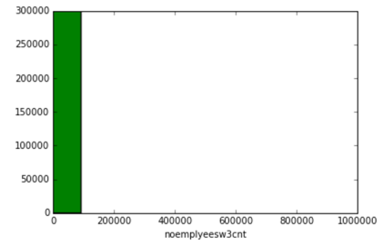
Naive Bayes
Number of employees

Slide 25
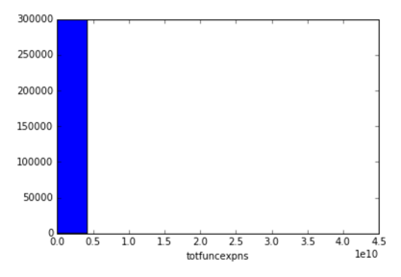
Naive Bayes
Total Functional Expenses

Slide 26
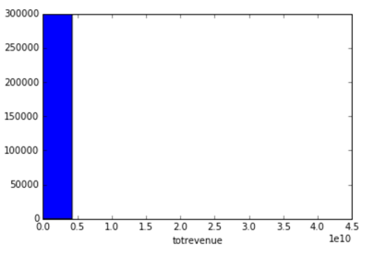
Naive Bayes
Total Revenue:

Slide 27
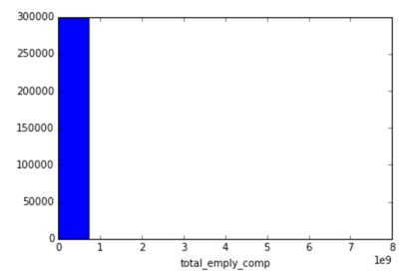
Naive Bayes
Total employee compensation

Slide 28
Naive Bayes
My inputs are not normally distributed!
The feature space is quantitative, so there isn’t a next best Naive Bayes alternative.
Next model!

Slide 29
Random Forest
With ‘int_compensation_classifier’ as my output:
used RandomForestClassifier
Maximum number of features = 5 and n_estimators = 1000
Out of bag error = 48%
CV_error is 48%
With ‘int_emplyee_comp_to_totalexpenses_classifier’ as my output:
used RandomForestClassifier
Maximum number of features = 5 and n_estimators = 1000
Out of bag error =59?%
CV_error is 59?%

Slide 30
Random Forest
With ‘totfuncexpns’ as my output:
Used RandomForestRegressor
No maximum number of features (bootstrap) and n_estimators = 1000
Out of bag error = 33%
CV_error is 59%
Note:
I’m not sure why I get the same values for the Out of Bag Error and the CV Error when using RandomForestClassifier, but I get different values when using RandomForestRegressor!

Slide 31
Conclusion
The inputs I used are not good predictors of either output int_compensation_classifier or int_emplyee_comp_to_totalexpenses_classifier
When I followed the indicators from my correlation matrix (‘totfuncexpns’) I was able to find a weak prediction using Random Forest.
I am am either not looking at existing independently correlated fields or they don’t exist.

Slide 32
Other Studies:
My search for articles on this dataset found several articles that were excited about the prospect of using the data for interpretation.
Stanford Social Innovation Review, “Liberating 990 Data”
Looking into non-3 agencies
Looking at trends in new nonprofits filing for the first time.
Compare to other datasets!
National Center for Charitable Statistics, “Mandated E-Filing: Toward a More Transparent Nonprofit Sector”
Track impact of mandatory online filing of 990 for some organizations has dramatically increased the counts of filing nonprofits!

Slide 33
Next Steps
Re-evaluate if any of the other 200+ fields are correlated.
Work on designing better hypothesis early on!

